Slide 1
Neural networks and Backpropagation
Jin Lu – UMDearborn
Notes:
For some domains, there is so much data (like computer vision) that we can allow the data speak for itself – there is no need to do “feature engineering”.
Professor claims we will see the new, near future by learning form this course.

Slide 2
Neural networks
Introduction
Different types of NN
Feed-forward Network (MLP)
Network Training
Error Back-propagation
Regularization

Slide 3
Introduction
Neuroscience studies how networks of neurons produce intellectual behavior, cognition, emotion and physiological responses
Computer science studies how to simulate the functions that biological neural network has
Artificial neural networks simulate the connectivity in the neural system, the way it passes through signal, and mimic the massively parallel operations of the human brain
Notes:
Right now: we know the function of the brain, we just do not know the mechanism by which it employs its functional scheme.

Slide 4
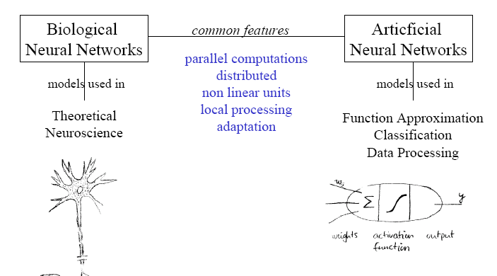
Common features
Dendrite
Cell body
Axon
Notes:
Biological: neurons pass information from chemical reactions which can release electrons
AI: electrical circuits used to pass the information along.
Watch butterfly effect movie! (professor mentioned it in relation to how field of physics uses function approximation abilities of AI)

Slide 5
Common features
Dendrite
Cell body
Axon
Notes:
Dendrite receives input from other neurons
Cell body processes input to decide if a pulse should be sent to the next neuron
Axon links to other neurons and carries output signals sent from cell body processing.

Slide 6
Common features
Parallel computing
Non-linear units
Local processing
Adaptation
Dendrite
Cell body
Axon
Notes:
Non-linear units and Local processing = happens within the cell body.
Issue: cannot measure the function used by the cell body because we do not have a way to (accurately/with enough precision) measure the signals sent from one neuron to the next.

Slide 7
Different types of NN
Feed-forward NN
Input Layer
Output Layer
FCN
Hidden Layer
Variants: CNN, ResNet, etc.
Notes:
FCN = Fully connected network (as shown above)
Deciding number of layers: depends on the data and your experience with tuning parameters/features (neural architecture search → NAS); it is a whole field of study and a specialty that comes with experience of the AI engineer.
Generally, with more data you should add more layers to improve model
With little data, we do not want to overfeed (overkill; waste resources and time and reduce accuracy) so you do not want to have too many layers.

Slide 8


Different types of NN
Recurrent NN (RNN)
$$o$$
w
V
h
U
$$x$$
Notes:
Many predictive tasks include time series data that are useful for future predictions; like time/price comparison of stock market; so RNN was designed.
For example, some parameters could be “number of tweets that mention Microsoft” and “big news announcements” and “how often Microsoft is mentioned in the news” to predict the stock price of Microsoft.
RNN does not only rely on current situation/input, but also past time (this is why it is called a recurrent neural network)
Includes loops as shown above as v→ use previous output of the model as next input for the next model run!
h = 1 or several layers of neural nets.

Slide 9
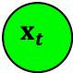
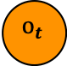

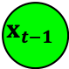

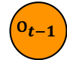
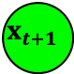

Different types of NN
Recurrent NN (RNN)
$$o$$
$$o_{t−1}$$
$$o_{t}$$
$$o_{t+1}$$
w
w
w
w
Unfold
V
h
$$⋯$$
h
h
h
$$⋯$$
V
V
V
V
U
U
U
U
$$x$$
$$x_{t−1}$$
$$x_{t}$$
$$x_{t+1}$$
Notes:
NLP (natural language processing) is a good example of where RNN is used because there is a lot of redundancy in language so you can make very good predictions based on previous words of a sentence (for example) → all words in a sentence have a strong dependency on the words before it (think about how gmail predicts the rest of your sentence).
LSTM, GRU, and GPT all are derived/use RNN.

Slide 10
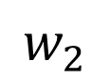
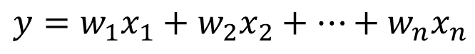
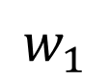
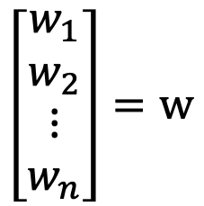
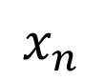
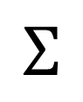
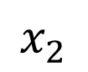
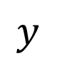
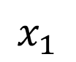
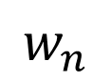
Linear perceptron
$$y=w_{1}x_{1}+w_{2}x_{2}+⋯+w_{n}x_{n}$$
$$x_{1}$$
$$w_{1}$$
Linear regression
$$x_{2}$$
$$w_{2}$$
$$y$$
$$Σ$$
$$w_{n}$$
$$\left[\begin{matrix}w_{1} \\ w_{2} \\ \begin{matrix}⋮ \\ w_{n}\end{matrix}\end{matrix}\right]=w$$
:
:
$$x_{n}$$
Weight vector
Input layer
output layer
Many functions can not be approximated using linear perceptron
Notes:
Problem: model is too simple → only linear operations done → not very useful to predict more complex/nonlinear systems because there is not enough complexity in the functions.

Slide 11
Linear Perceptron
XOR (exclusive OR) problem
0+0=0
1+1=2=0 mod 2
1+0=1
0+1=1
Linear perceptron generates a linear decision boundary
Linear perceptron does not work here!
Notes:
Square means output is 1, circle means output is 0
What if we wanted to approximate f(x1, x2) = XOR(x1, x2); we cannot because there is no linear decision boundary that can pass through or even closely approximate all 4 outputs as shown above.

Slide 12
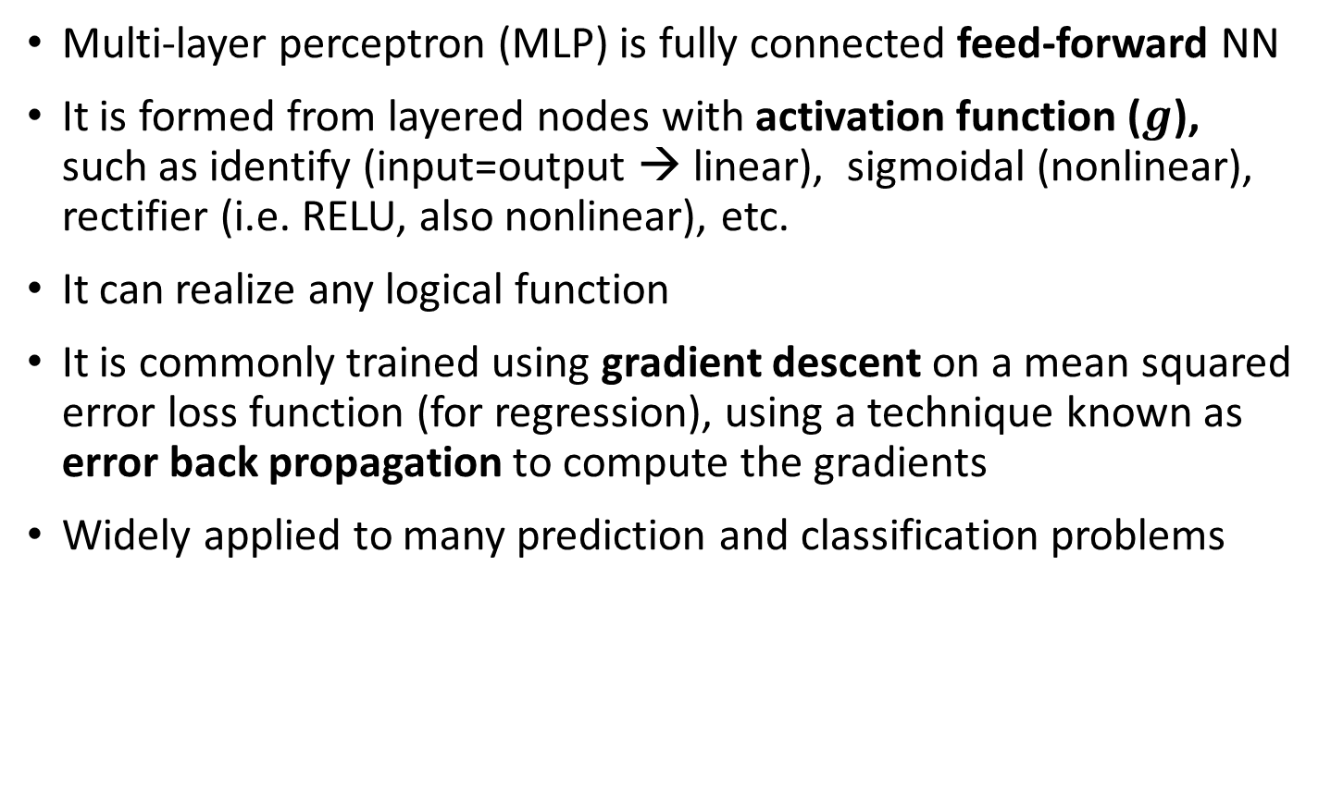
Multi-Layer Perceptron
Multi-layer perceptron (MLP) is fully connected feed-forward NN
It is formed from layered nodes with activation function ($g$), such as identify (input=output → linear), sigmoidal (nonlinear), rectifier (i.e. RELU, also nonlinear), etc.
It can realize any logical function
It is commonly trained using gradient descent on a mean squared error loss function (for regression), using a technique known as error back propagation to compute the gradients
Widely applied to many prediction and classification problems
Notes:
Solve linear perceptron problem that occurs with some systems using nonlinear activation function.

Slide 13
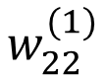
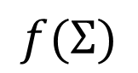
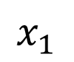
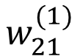
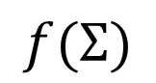
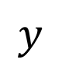
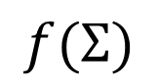
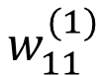
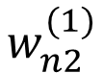
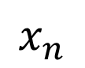
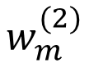
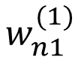
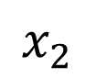
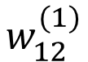
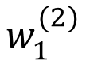
Multi-Layer Perceptron
$$x_{1}$$
$$w_{11}^{(1)}$$
$$w_{12}^{(1)}$$
$$f(Σ)$$
$$x_{2}$$
$$w_{21}^{(1)}$$
$$w_{1}^{(2)}$$
$$y$$
:
:
$$f(Σ)$$
$$w_{22}^{(1)}$$
:
:
$$w_{m}^{(2)}$$
$$w_{n1}^{(1)}$$
$$f(Σ)$$
$$x_{n}$$
$$w_{n2}^{(1)}$$
Input layer
Hidden layer
output layer
Each neuron except those in the input layer receives inputs from the previous layer, and reports an output to next layer
Each link is associated with a weight, and these weights are parameters to be learned
Notes:
Each parameter (weight) is trainable.
Above is a FCN (fully connected network)

Slide 14
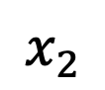
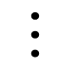
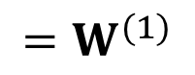
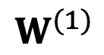
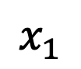
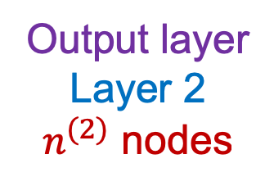
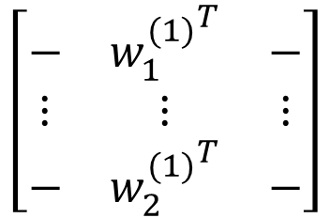
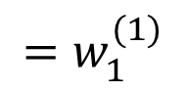
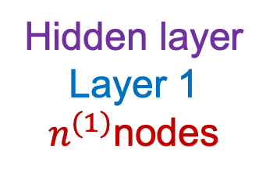
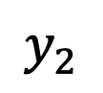
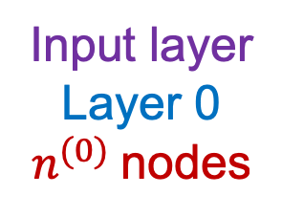
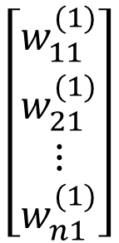
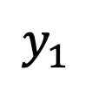
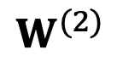
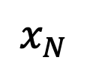
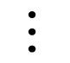
Notations
$$x_{1}$$
$$y_{1}$$
$$x_{2}$$
$$W^{(1)}$$
$$⋯$$
$$W^{(2)}$$
$$y_{2}$$
$$⋯$$
$$x_{N}$$
Input layer
Layer 0
$n^{(0)}$nodes
Hidden layer
Layer 1
$n^{(1)}$nodes
Output layer
Layer 2
$n^{(2)}$ nodes
$$\left[\begin{matrix}w_{11}^{(1)} \\ w_{21}^{(1)} \\ \begin{matrix}⋮ \\ w_{n1}^{(1)}\end{matrix}\end{matrix}\right]$$
$$\left[\begin{matrix}− & {w_{1}^{(1)}}^{T} & − \\ ⋮ & ⋮ & ⋮ \\ − & {w_{2}^{(1)}}^{T} & −\end{matrix}\right]$$
$$=w_{1}^{(1)}$$
$$=W^{(1)}$$

Slide 15
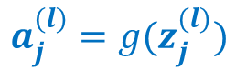
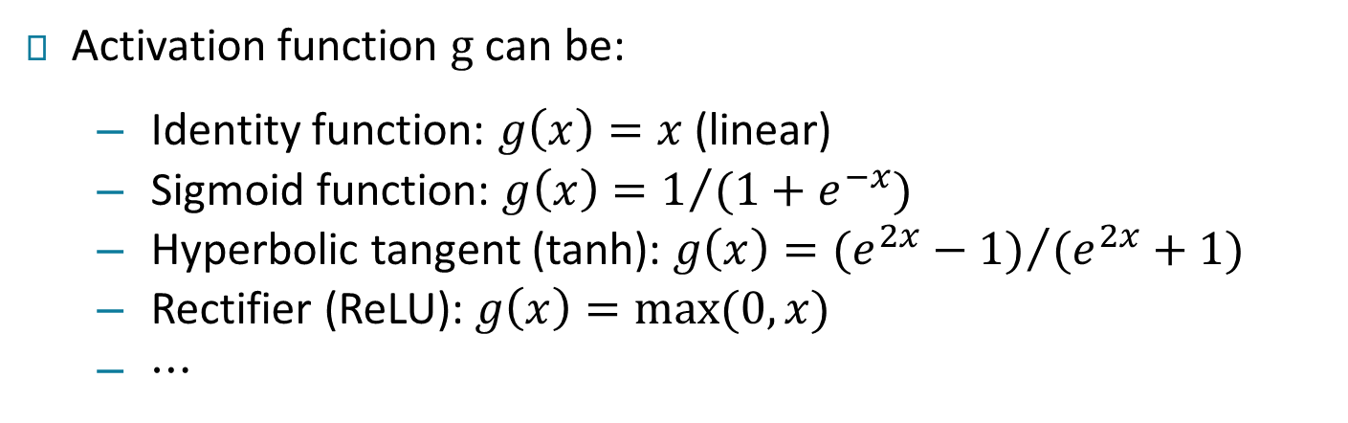




Each neuron
$$z_{j}^{(l)}=\sum_{i=1}^{n^{(l−1)}}{w_{ij}^{(l)}a_{i}^{(l−1)}}$$
$$w_{1j}^{(l)}$$
$$w_{2j}^{(l)}$$
Σ
$$a_{j}^{(l)}=g(z_{j}^{(l)})$$
$$w_{n^{(l−1)}j}^{(l)}$$
summation
g is Activation function
Activation function $g$can be:
Identity function: $g\left(x\right)=x$ (linear)
Sigmoid function: $g\left(x\right)=1/{(1+e^{−x})}$
Hyperbolic tangent (tanh): $g\left(x\right)={(e^{2x}−1)}/{(e^{2x}+1)}$
Rectifier (ReLU): $g\left(x\right)=max⁡(0,x)$
$⋯$

Slide 16












Forward Computation
Signal flows
$$x_{1}$$
$$y_{1}$$
$$x_{2}$$
$$W^{(1)}$$
$$⋯$$
$$W^{(2)}$$
$$y_{2}$$
$$⋯$$
$$x_{N}$$
Layer 0
Layer 1
Layer 2
The output from each hidden node (layer 1)
The final output
$$a_{j}^{(1)}=f\left(\sum_{i=1}^{n^{(0)}}{w_{ij}^{(1)}a_{i}^{(0)}}\right)$$
$$a_{i}^{(0)}=x_{i}$$
$${y_{j}=a}_{j}^{(2)}=f\left(\sum_{i=1}^{n^{(1)}}{w_{ij}^{(2)}a_{i}^{(1)}}\right)$$
Notes:
The f function above is the activation function
Basic concept: linear function, then activation function, repeat…until you get output.

Slide 17


Universal Approximation of MLP (multi-layer perceptron)
MLP with 1 hidden layer can represent any bounded continuous function to arbitrary $ε$
Universal Approximation Theorem [George Cybenko 1989]
Notes:
Scientist developed a model where you can draw any bounded continuous function and the neural network with 1 hidden layer can predict/approximate the function very accurately.

Slide 18





Network for Computing logic functions
$$x_{1 } OR{ x}_{2}$$
bias node
+1
-10
20
$$x_{1}$$
$$f_{w}(x)$$
20
$$x_{2}$$
Activation function
$$g\left(z\right)=\frac{1}{1+e^{−z}}$$

Slide 19


Network for Computing logic functions
$$x_{1 } AND { x}_{2}$$
+1
-30
20
$$x_{1}$$
$$f_{w}(x)$$
20
$$x_{2}$$
Activation function
$$g\left(z\right)=\frac{1}{1+e^{−z}}$$

Slide 20

Network for Computing logic functions
$$(NOT x_{1}) AND (NOT{ x}_{2})$$
+1
10
-20
$$x_{1}$$
$$f_{w}(x)$$
-20
$$x_{2}$$
Activation function
$$g\left(z\right)=\frac{1}{1+e^{−z}}$$

Slide 21






Network for Computing logic functions
+1
+1
-30
10
$$x_{1 } XOR{ x}_{2}$$
10
-20
$$f_{w}(x)$$
$$x_{1}$$
20
$$a_{1}^{(1)}$$
-20
-20
20
-20
$$a_{2}^{(1)}$$
$$x_{2}$$
Notes:
Note: initialization is very important; if you initialize parameters and it turns out as very bad initial values, then it could be a longer time to train those parameters.
Very critical to do preprocessing of the data for initializing the weights before training.

Slide 22

Artificial Neuron

Slide 23

Artificial Neuron
Notes:
F(x) = g(z(x))

Slide 24

Layer of Neurons

Slide 25

Layer of Neurons

Slide 26

One Hidden Layer Network

Slide 27

One Hidden Layer Network

Slide 28

One Hidden Layer Network

Slide 29

One Hidden Layer Network

Slide 30

One Hidden Layer Network
Notes:
Sigmoid and Relu often used in hidden layers; often final activation function used is softmax for the purpose of classification (for final output).

Slide 31

One Hidden Layer Network

Slide 32

Element-wise activation functions
blue: activation function
green: derivative (gradient)
Notes:
Gradient will show you how long the model will take to train the parameters and update them significantly if it uses the respective activation functions as shown above; ReLu will help you learn much faster but of course does not offer as much accuracy because learning is too fast.

Slide 33



Network Training
A supervised neural network is a function $f_{w}(x)$ that maps from inputs $x$ to target $y$
Usually training a NN does not involve the change of NN structures (such as how many hidden layers or how many hidden nodes)
Training NN refers to adjusting the values of connection weights so that $f_{w}(x)$ adapts to the problem
Use sum of squares as the error metric (for regression)
$$E\left(w\right)=\sum_{l=1}^{L}{{\left(y_{l}−f_{w}\left(x_{l}\right)\right)}^{2}}$$
Use gradient descent: $d_{k}=−\frac{∂E(w)}{∂w_{ij}^{(k)}}$
Notes:
E(w) →“for L data points, we want to minimize distance between each data point and the true value” → minimizes error.

Slide 34


Gradient descent
An optimizing algorithm used in Machine/ Deep Learning algorithms.
The goal is to minimize the objective convex function f(x) using iteration.
machine learning model always wants low error i.e. maximum accuracy
Error = Y(Predicted)-Y(Actual)
Steps to implement Gradient Descent
Randomly initialize values.
Update values iteratively

Slide 35

Gradient descent
Iterative algorithm containing many iterations
Each iteration $t$, the weights $w$ receive a small update
$$w_{ij}^{t}=w_{ij}^{t−1}+α\left(−\frac{∂E}{∂w_{ij}}\right)$$
Terminate
until the network is stable (in other words, the training error cannot be reduced further)
$E\left(w^{t}\right)<E(w^{t−1})$ not hold
until the error on a validation set starts to climb up (early stopping)
Learning Rate

Slide 36

Gradient descent - Example
Objective function: $E\left(w\right)=w^{2}$

Slide 37










Error Back-propagation
Signal flows
$$x_{1}$$
$$w_{11}^{(1)}$$
$$x_{2}$$
$$w_{1M}^{(1)}$$
$$w_{1}^{(2)}$$
…
$$h_{w}(x)$$
…
$$w_{M}^{(2)}$$
$$x_{N}$$
$$w_{NM}^{(1)}$$
Learning is backwards
The update of the weights goes backwards because we have to use the chain rule to evaluate the gradient of $E(w)$

Slide 38





Error Back-propagation
Learning is backwards
$$x_{1}$$
$$w_{11}^{(1)}$$
$$x_{2}$$
$$w_{1M}^{(1)}$$
$$w_{1}^{(2)}$$
…
$$h_{w}(x)$$
…
$$w_{M}^{(2)}$$
$$x_{N}$$
$$w_{NM}^{(1)}$$
Calculate the gradient associated with the weights in the output layer first
Propagate from the high layer to low layer
Recall
$$a_{j}^{(1)}=f\left(\sum_{i=1}^{N}{w_{ij}^{(1)}x_{i}}\right)$$
$$h_{w}\left(x\right)=f\left(\sum_{j=1}^{M}{w_{j}^{(2)}a_{j}^{(1)}}\right)$$

Slide 39










Evaluate gradient
$$E\left(w\right)=\sum_{l=1}^{L}{{\left({\hat{y}}_{l}−y_{l}\right)}^{2}=\sum_{l=1}^{L}{E_{l}}}, where {\hat{y}}_{l}=h_{w}\left(x_{l}\right)$$
First compute the partial derivatives for weights in the output layer
$$\frac{∂{\hat{y}}_{l}}{∂w_{j}^{(2)}}$$
$$\frac{∂E_{l}}{∂{\hat{y}}_{l}}$$
$$=2\left({\hat{y}}_{l}−y_{l}\right)f′\left(\sum_{j=1}^{M}{w_{j}^{(2)}}a_{j}^{(1)}\right)a_{j}^{(1)}$$
$$\frac{∂E_{l}}{∂w_{j}^{(2)}}=\frac{∂E_{l}}{∂{\hat{y}}_{l}}\frac{∂{\hat{y}}_{l}}{∂w_{j}^{\left(2\right)}}$$
Second compute the partial derivatives for weights in the hidden layer
$$\frac{∂{\hat{y}}_{l}}{∂a_{j}^{(1)}}$$
$$\frac{∂a_{j}^{(1)}}{∂w_{ij}^{(1)}}$$
$$\frac{∂E_{l}}{∂{\hat{y}}_{l}}$$
$$\frac{∂E_{l}}{∂w_{ij}^{(1)}}=\frac{∂E_{l}}{∂{\hat{y}}_{l}}\frac{∂{\hat{y}}_{l}}{∂a_{j}^{(1)}}\frac{∂a_{j}^{(1)}}{∂w_{ij}^{(1)}}$$
$$=2\left({\hat{y}}_{l}−y_{l}\right)f′\left(\sum_{j=1}^{M}{w_{j}^{(2)}}a_{j}^{(1)}\right)w_{j}^{(2)}f′\left(\sum_{i=1}^{N}{w_{ij}^{(1)}}x_{l,i}\right)x_{l,i}$$

Slide 40


Evaluate gradient
$$\frac{∂E_{l}}{∂w_{j}^{(2)}}=2\left({\hat{y}}_{l}−y_{l}\right)f′\left(\sum_{j=1}^{M}{w_{j}^{(2)}}a_{j}^{(1)}\right)a_{j}^{(1)}$$
Layer 2
$$\frac{∂E_{l}}{∂w_{ij}^{(1)}}=2\left({\hat{y}}_{l}−y_{l}\right)f′\left(\sum_{j=1}^{M}{w_{j}^{(2)}}a_{j}^{(1)}\right)w_{j}^{(2)}f′\left(\sum_{i=1}^{N}{w_{ij}^{(1)}}x_{i}\right)x_{i}$$
Layer 1
Back-propagation
Exploding/vanishing gradient

Slide 41

Stochastic Gradient Descent
Initialize $θ$ randomly

Slide 42

Stochastic Gradient Descent (SGD)
Initialize $θ$ randomly
For $E$ epochs perform:
Randomly select a small batch of samples ($B⊂S$)

Slide 43

Stochastic Gradient Descent
Initialize $θ$ randomly
For $E$ epochs perform:
Randomly select a small batch of samples ($B⊂S$)
Compute gradients: $Δ=∇_{θ}L_{B}(θ)$

Slide 44

Stochastic Gradient Descent
Initialize $θ$ randomly
For $E$ epochs perform:
Randomly select a small batch of samples ($B⊂S$)
Compute gradients: $Δ=∇_{θ}L_{B}(θ)$
Update parameters: $θ←θ−ηΔ$
$η>0$ is called the learning rate

Slide 45

Stochastic Gradient Descent
Initialize $θ$ randomly
For $E$ epochs perform:
Randomly select a small batch of samples ($B⊂S$)
Compute gradients: $Δ=∇_{θ}L_{B}(θ)$
Update parameters: $θ←θ−ηΔ$
$η>0$ is called the learning rate
Repeat until the epoch is completed (all of $S$ is covered)

Slide 46

Stochastic Gradient Descent
Initialize $θ$ randomly
For $E$ epochs perform:
Randomly select a small batch of samples ($B⊂S$)
Compute gradients: $Δ=∇_{θ}L_{B}(θ)$
Update parameters: $θ←θ−ηΔ$
$η>0$ is called the learning rate
Repeat until the epoch is completed (all of $S$ is covered)
Stop when reaching criterion:
all stops decreasing when computed on validation set

Slide 47
Loss, Initialization and Learning Tricks

Slide 48

Discrete output (classification)

Slide 49

Continuous output (regression)

Slide 50
Initialization and normalization
Input data should be normalized to have approx. same range:
standardization or quantile normalization

Slide 51

Initialization and normalization
Input data should be normalized to have approx. same range:
standardization or quantile normalization
Initializing $W^{h}$ and $W^{o}$:
Zero is a saddle point: no gradient, no learning

Slide 52

Initialization and normalization
Input data should be normalized to have approx. same range:
standardization or quantile normalization
Initializing $W^{h}$ and $W^{o}$:
Zero is a saddle point: no gradient, no learning
Constant init: hidden units collapse by symmetry

Slide 53

Initialization and normalization
Input data should be normalized to have approx. same range:
standardization or quantile normalization
Initializing $W^{h}$ and $W^{o}$:
Zero is a saddle point: no gradient, no learning
Constant init: hidden units collapse by symmetry
Solution: random init, ex: $w∼N(0, 0.01)$

Slide 54

Initialization and normalization
Input data should be normalized to have approx. same range:
standardization or quantile normalization
Initializing $W^{h}$ and $W^{o}$:
Zero is a saddle point: no gradient, no learning
Constant init: hidden units collapse by symmetry
Solution: random init, ex: $w∼N(0, 0.01)$
Better inits: Xavier Glorot and Kaming He & orthogonal

Slide 55

Initialization and normalization
Input data should be normalized to have approx. same range:
standardization or quantile normalization
Initializing $W^{h}$ and $W^{o}$:
Zero is a saddle point: no gradient, no learning
Constant init: hidden units collapse by symmetry
Solution: random init, ex: $w∼N(0, 0.01)$
Better inits: Xavier Glorot and Kaming He & orthogonal
Biases can (should) be initialized to zero
Notes:
Initializing weights as 0 is not good
Initializing all weights with same value even if not 0 is also not good (will collapse the model)

Slide 56
SGD Learning rate
Very sensitive:
Too high → early plateau or even divergence
Too low → slow convergence

Slide 57

SGD Learning rate
Very sensitive:
Too high → early plateau or even divergence
Too low → slow convergence
Try a large value first: $η=0.1$or even $η=1$
Divide by 10 and retry in case of divergence

Slide 58

SGD Learning rate
Very sensitive:
Too high → early plateau or even divergence
Too low → slow convergence
Try a large value first: $η=0.1$or even $η=1$
Divide by 10 and retry in case of divergence
Large constant LR prevents final convergence
multiply $η_{t}$ by $β<1$after each update

Slide 59

SGD Learning rate
Very sensitive:
Too high → early plateau or even divergence
Too low → slow convergence
Try a large value first: $η=0.1$or even $η=1$
Divide by 10 and retry in case of divergence
Large constant LR prevents final convergence
multiply $η_{t}$ by $β<1$after each update
or monitor validation loss and divide $η_{t}$by 2 or 10 when no progress
See ReduceLROnPlateau in Keras

Slide 60


Momentum
Accumulate gradients across successive updates:
$γ$ is typically set to 0.9

Slide 61
Momentum
Accumulate gradients across successive updates:
$γ$ is typically set to 0.9
Larger updates in directions where the gradient sign is constant to accelerate in low curvature areas

Slide 62

Momentum
Accumulate gradients across successive updates:
$γ$ is typically set to 0.9
Larger updates in directions where the gradient sign is constant to accelerate in low curvature areas
Nesterov accelerated gradient
Better at handling changes in gradient direction.

Slide 63

Why Momentum Really Works

Slide 64

Why Momentum Really Works

Slide 65

Why Momentum Really Works

Slide 66

Why Momentum Really Works

Slide 67

Alternative optimizers
SGD (with Nesterov momentum)
Simple to implement
Very sensitive to initial value of $η$
Need learning rate scheduling

Slide 68

Alternative optimizers
SGD (with Nesterov momentum)
Simple to implement
Very sensitive to initial value of $η$
Need learning rate scheduling
Adam: adaptive learning rate scale for each param
Global $η$ set to 3e-4 often works well enough
Good default choice of optimizer (often)

Slide 69
Alternative optimizers
SGD (with Nesterov momentum)
Simple to implement
Very sensitive to initial value of $η$
Need learning rate scheduling
Adam: adaptive learning rate scale for each param
Global $η$ set to 3e-4 often works well enough
Good default choice of optimizer (often)
But well-tuned SGD with LR scheduling can generalize better than Adam (with naive l2 reg)...

Slide 70
Alternative optimizers
SGD (with Nesterov momentum)
Simple to implement
Very sensitive to initial value of $η$
Need learning rate scheduling
Adam: adaptive learning rate scale for each param
Global $η$ set to 3e-4 often works well enough
Good default choice of optimizer (often)
But well-tuned SGD with LR scheduling can generalize better than Adam (with naive l2 reg)...
Active area of research: K-FAC stochastic second-order method based on an invertible approximation of the Fisher information matrix of the network.

Slide 71

The Karpathy Constant for Adam
Notes:
No explanation for why 3*10^-4 is best learning rate (step size) to use for converging on an accurate solution the fastest.

Slide 72

Optimizers around a saddle point
Credits: Alec Radford
Notes:
First run ADAM, then run SGD (combine ADAM and SGD) to get better performance without sacrificing training speed.

